Slide 1
Multi-Model RAG
Chatbot
Presented by
Blesson Samuel L

Slide 2
Multi-Model RAG Chatbot
RAG-Powered Chatbot: Combines retrieval and generation for accurate, context-aware responses.
Voice & Text Support: Enables natural conversation via speech or typing.
PDF Knowledge Uploads: Users can query custom documents, not just built-in knowledge.
AI + FAISS Integration: Uses Google GenAI and vector search for smart retrieval.
API-Ready Backend: FastAPI-based, easily integrates with apps and platforms.

Slide 3
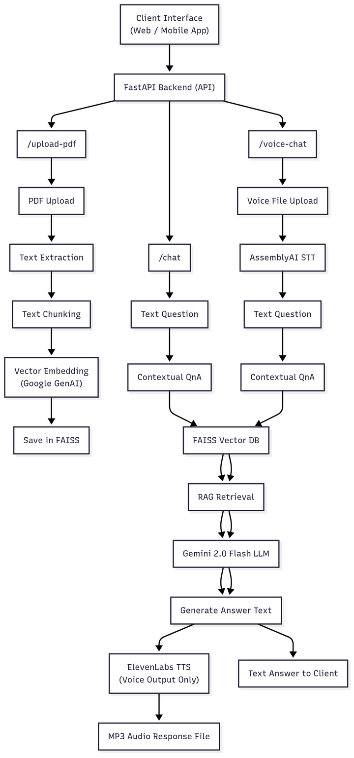
Architecture Diagram

Slide 4
Future Enhancements
Multi-Document Upload – Support multiple PDFs with separate or merged knowledge indexing.
Advanced Semantic Search – Add filters by section, author, date, or keyword.
Persistent Context – Maintain user history across sessions for personalized replies.
Voice Features Upgrade – Add multilingual support, emotion detection, and speaker separation.
Real-Time Knowledge Updates – Ingest live web and database data automatically.
Tool Integrations – Connect with Slack, Teams, and other enterprise tools.

Slide 5
Key Features
Multi-Modal Chat: Supports both text and voice input/output for flexible interaction.
PDF Knowledge Uploads: Parses and embeds PDFs for custom, document-based Q&A.
RAG Architecture: Combines vector search with LLMs for accurate, context-rich answers.
Contextual Memory: Remembers chat history for coherent, ongoing conversations.
Voice Integration: Uses AssemblyAI & ElevenLabs for speech-to-text and text-to-speech.

Slide 6
Conclusion
Versatile Interaction: Seamless voice and text chat with contextual memory.
Custom Knowledge: Easily upload and query multiple user PDFs.
Smart Retrieval: RAG architecture with semantic search and vector embeddings.
Scalable & API-Ready: FastAPI backend ready for web, mobile, and team integrations.
Future-Ready: Supports real-time updates, multilingual voice, and enterprise tools.

